Slide 1
Total Military Expenditure
Individual Project 1
DATS 6103 (Sec 10)

Slide 2
Data
Data is from the World Development Indicators published by the World Bank
Data time range covers 1960 to 2016
Three variables were taken:
Military expenditure (% of GDP)
GDP (current US$)
Population, total
Further variables were created from these three
Convert into longitudinal dataset into to Cross-Sectional Panel Data
 |  | Military Expenditure per GDP | GDP | Population | Military Total Expenditure | Military Expenditure per Capita
Country Name | Years
Afghanistan | 2010 | 1.90 | 15936800636.25 | 28803167.00 | 302396449.47 | 10.50
 | 2011 | 1.78 | 17930239399.81 | 29708599.00 | 318905914.33 | 10.73
 | 2012 | 1.14 | 20536542736.73 | 30696958.00 | 235084908.44 | 7.66
 | 2013 | 1.05 | 20264253974.11 | 31731688.00 | 212778504.08 | 6.71
 | 2014 | 1.30 | 20616104297.67 | 32758020.00 | 267541047.58 | 8.17
 | 2015 | 0.99 | 19215562178.98 | 33736494.00 | 190897729.21 | 5.66
 | 2016 | 0.89 | 19469022207.64 | 34656032.00 | 173729131.95 | 5.01
Albania | 1960 | nan | nan | 1608800.00 | nan | nan
 | 1961 | nan | nan | 1659800.00 | nan | nan
 | 1962 | nan | nan | 1711319.00 | nan | nan
 | 1963 | nan | nan | 1762621.00 | nan | nan

Slide 3
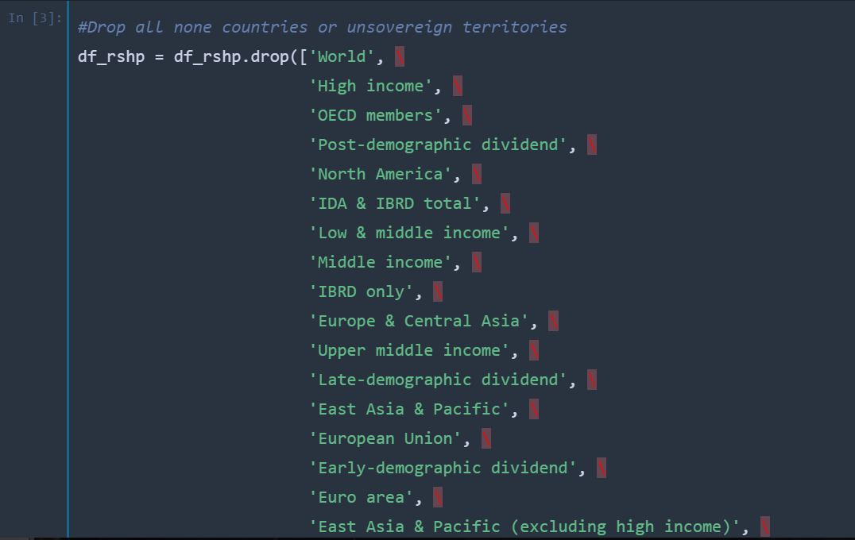
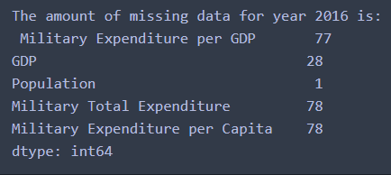
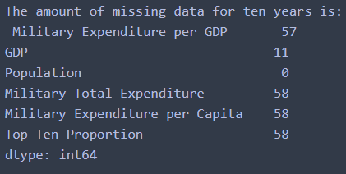
Data Cleaning
Took the monotonous route to remove none countries or non-sovereign territories
Missing data for 2016 was above 75 for military expenditure-based variables, but almost zero for population estimates
Missing data averaging the past ten years only slightly improved missing
Will not impute data
Notes:
The amount of missing data does not appear to be a major issue; will mostly look at the year 2016 as opposed to an average of the last ten years

Slide 4
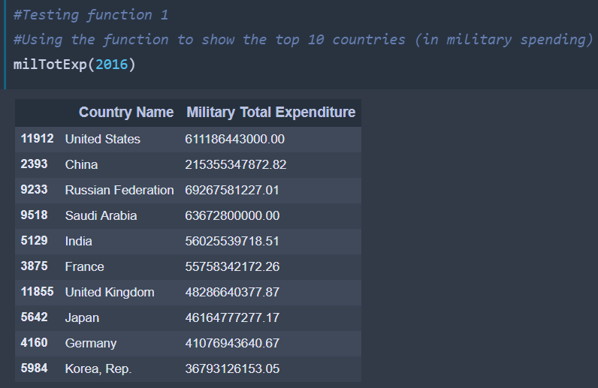
Function 1
Created 3 functions to data mine
Function 1: Table sorting the top countries
military total expenditure
total military spending per GDP
percentage of military spending of the top ten
total military spending per capita
Default sorted by military total expenditure
Can show only country names sorted by any military total expenditure or the other three categories
Can show only the amounts sorted by military total expenditure
Can change the table row length
Notes:
#Table of Top Countries
#Create function 1: Table sorting the top countries
#View countries sorted by military total expenditure with total military spending per GDP,
# percentage of military spending of the top ten, &
# total military spending per capita.
#Can show only country names sorted by any military total expenditure or the other three categories
#Can show only the amounts sorted by military total expenditure
#Can change the table row length from 10 to any other number (up to 219 countries/terrorities in dataset)

Slide 5
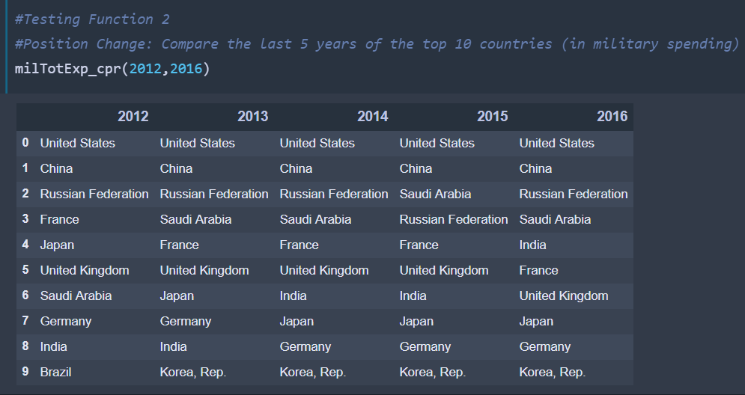
Function 2
Function 2: Table showing positional change of categories using time range as columns
Same 4 variables can be used
Time range can be any length
Can show only country names sorted by the 4 variables
Can show only the amounts sorted by military total expenditure
Can change the table row length
Notes:
#Table of Top Countries over Time
#Create function 2: Table showing positional change of categories using time range as columns
#View countries sorted by military total expenditure,
# total military spending per GDP,
# percentage of military spending of the top ten, &
# total military spending per capita.
#Can show only country names sorted by any military total expenditure or the other three categories
#Can show only the amounts sorted by military total expenditure
#Can change the table row length from 10 to any other number (up to 219 countries/territories in dataset)

Slide 6
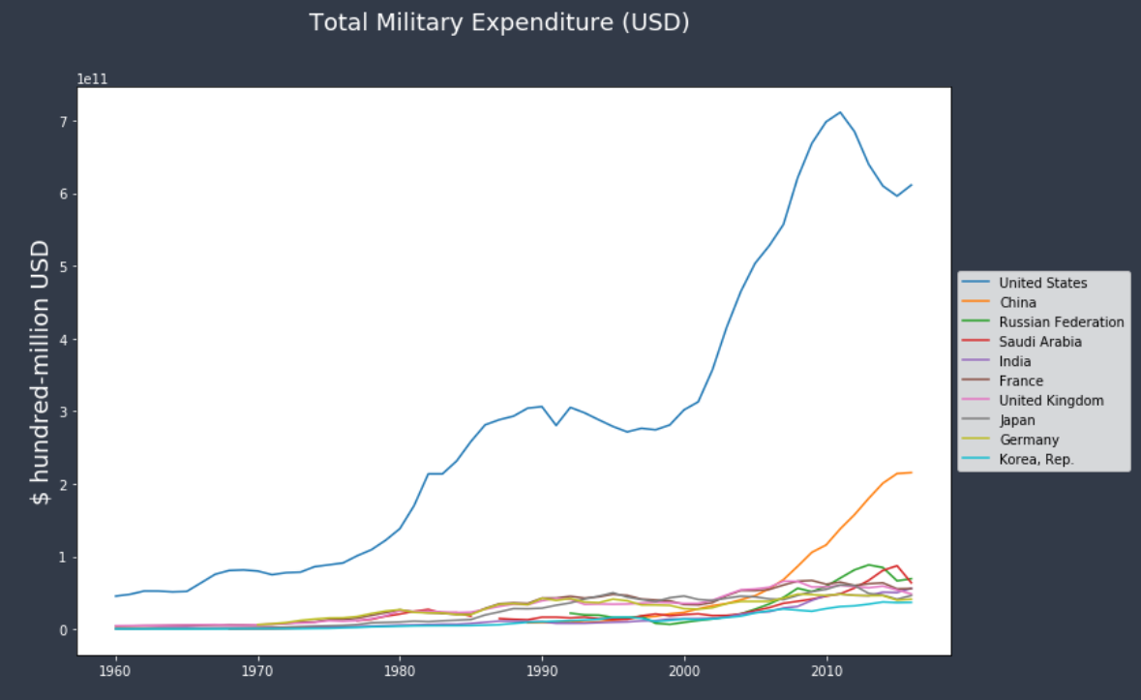
Function 3
Function 3: Line graph showing country of input by one of 4 categories using 2 potential time ranges
Can range from 1960 to 2016 or 2007 to 2016
Can define color of line
Can change the width of the lines
Notes:
#Line Graph of Top Countries
#Create function 3: Line graph showing country of input by one of 4 categories using 2 potential time ranges
#View countries by military total expenditure,
# total military spending per GDP,
# percentage of military spending of the top ten, &
# total military spending per capita.
#Can range from 1960 to 2016 or 2007 to 2016
#Can define color of line

Slide 7
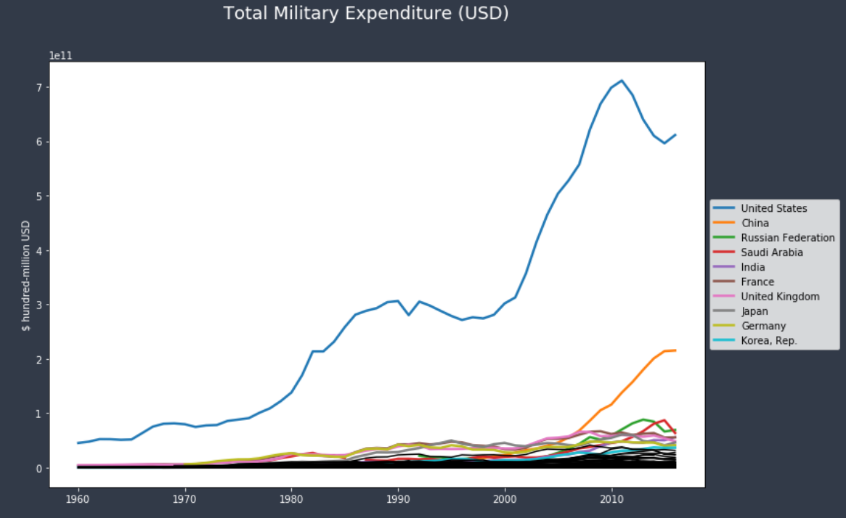
Top Ten Countries in Total Military Expenditure
The United States clearly stands out as the largest in total military expenditure
The United States also appear volatile, falling in the late 1990s and around 2009, coinciding with two democratic president
The largest U.S. increases were in the 1980s under President Reagan and the 2000s under George W. Bush
Added the other 209 countries in black
Only around two other countries compete with the top ten countries

Slide 8
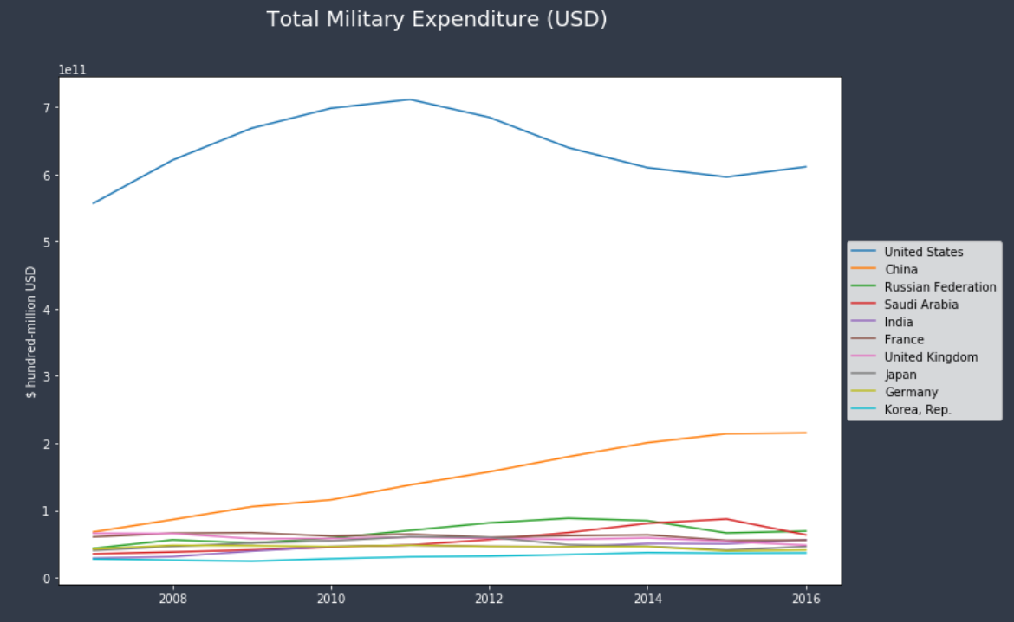
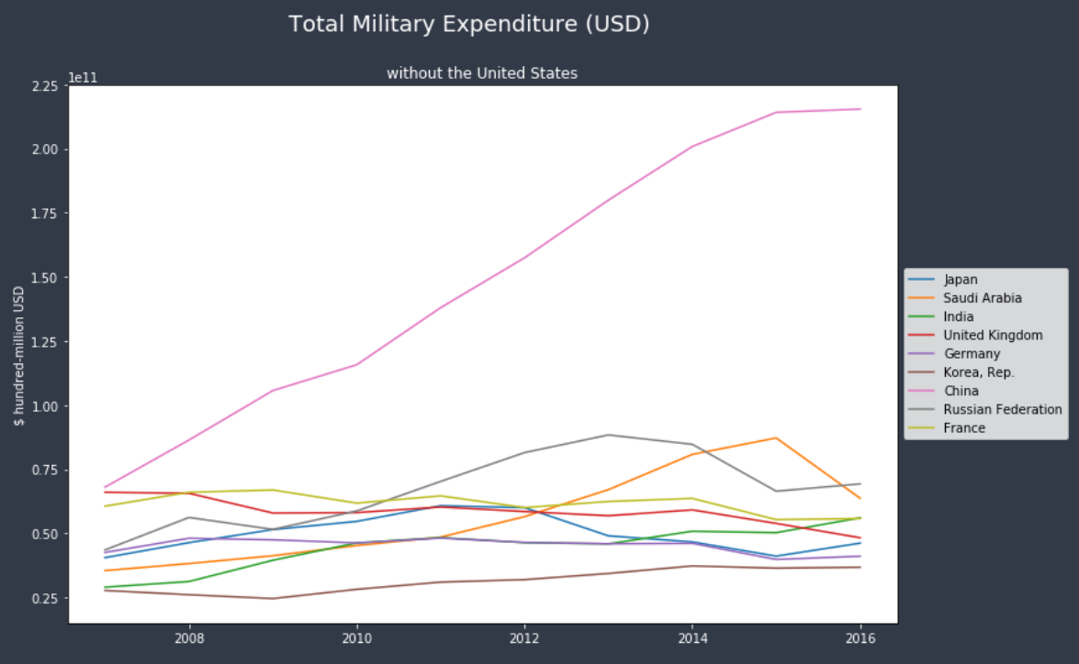
Top Ten Countries in Total Military Expenditure
Limiting the graphs to ten years shows that most countries are similar with the United States as a clear outlier
Removing the U.S. shows that China is dramatically growing its military total expenditure
Unexpectedly, the small country of Saudi Arabia has a high amount of spending similar to that of Russia

Slide 9
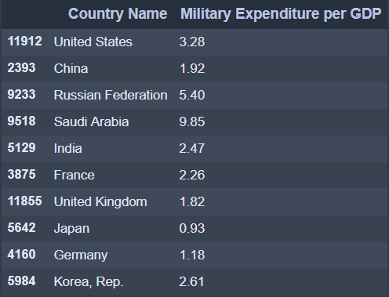
Compare Military Expenditure per GDP
The table to the right is sorted by military total expenditure
The United States, number one in military total expenditure is number three in military expenditure per GDP
Saudi Arabia, fourth in military total expenditure, is easily the highest
Russia is also very high
Japan is the only country below 1 percent

Slide 10
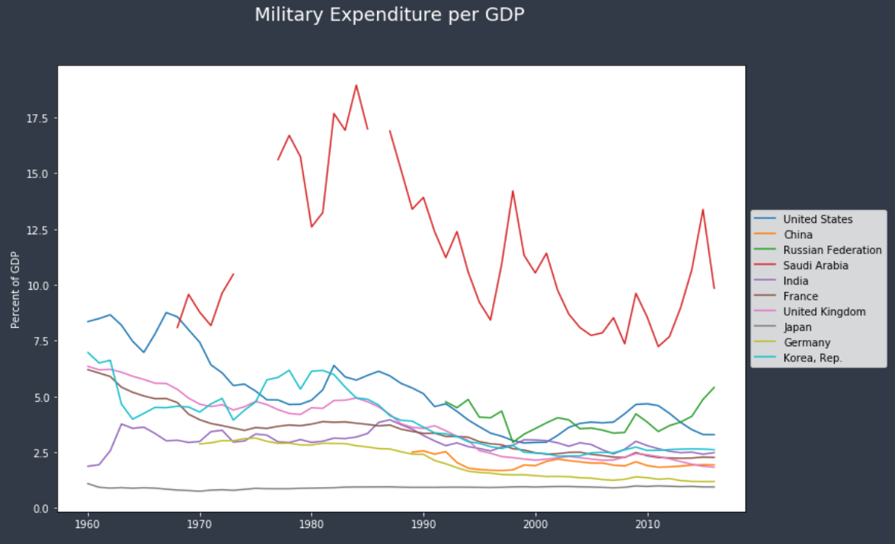
Compare Military Expenditure per GDP
Historically, Saudi Arabia has always been the highest in military expenditure per GDP
In recent years, Russia has increased its per GDP expenditure
Japan has always been low

Slide 11
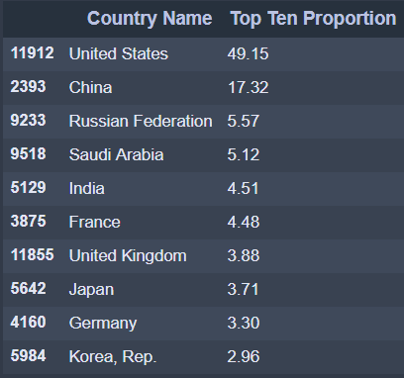
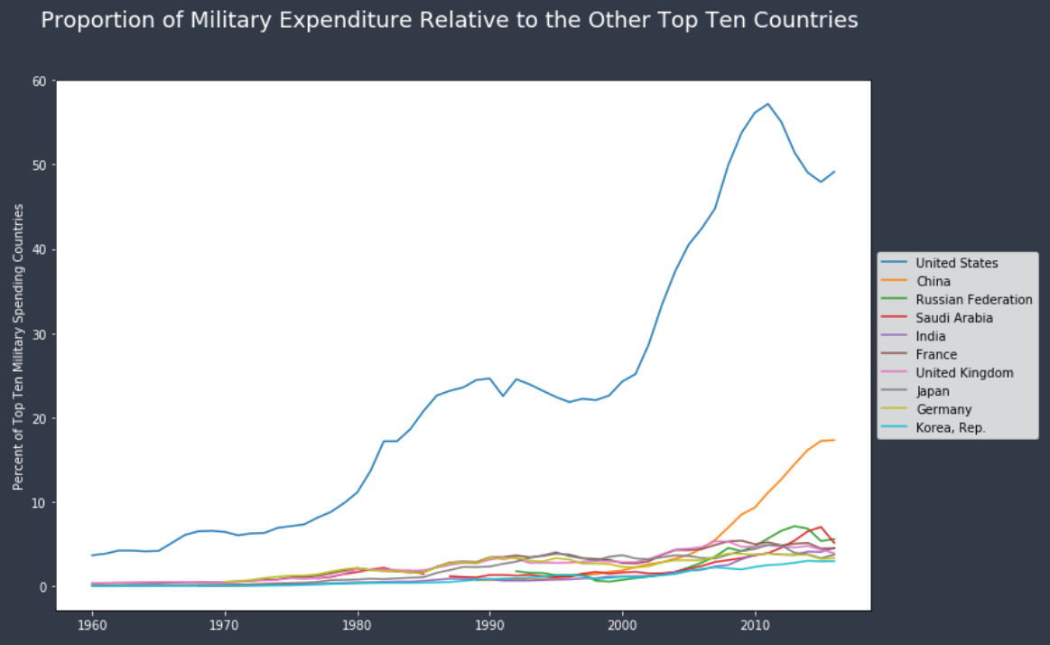
Proportion of Military Expenditure Relative to the Other Top Ten Countries
The United States possesses almost half of all military expenditure out of the top ten countries
Russia, the third largest spender, is almost 1/10th
Looks similar in graph-form to military total expenditure

Slide 12
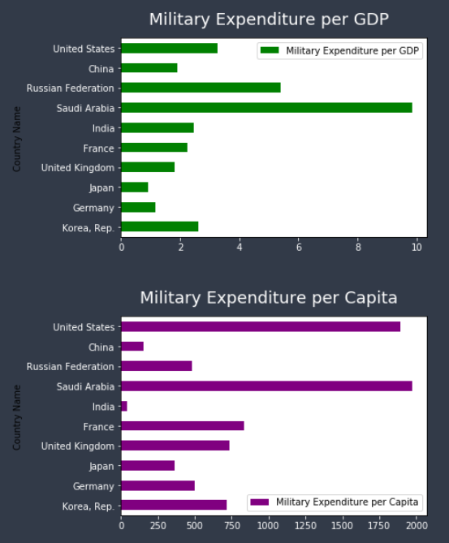
Per GDP military spending and per Capita
Saudi Arabia is easiest the highest in both per GDP and per person expenditure
Indicates that it routes far more of its resources to its military than other countries
The United States spends a lot per capita, but very little per GDP
Reveals that its GDP is high in absolute terms, but that its population is small relative to its military total expenditure

Slide 13
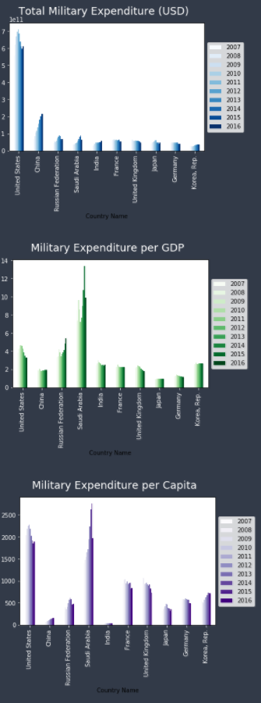
Compare the fastest growing countries in military spending in fixed value and in percentage
The United States has declined quite substantially in fixed value spending and in relation to its economy or population
The declined in fixed value spending is more notable as only China, Russia, and Saudi Arabia have had major changes (increases) in fixed value spending in the past 10 years
China has increased its fixed value spending the most, but has not increased its per GDP or per capita spending substantially
In examining fixed value, the small country of Saudi Arabia stands out as being in fourth position and growing
This seems to be because it has been the most aggressive in increasing its per GDP and per capita spending in the past 10 years
Russia has increased substantially in per GDP spending
South Korea has increased in per capita spending
The United Kingdom has declined in per GDP and per capita but not in military total expenditure
Its economy and population has likely been increasing at this time

Slide 14
Conclusion
United States spends the most in overall military expenditure and is also high in per capita spending and (slightly less so) in per GDP spending
However, it has been decreasing its spending in the past 10 years
China has increased the most in military total expenditure as well as its relative expenditure relative to the other top ten countries
However, this is not because it is diverting more of its resources in terms of its economy or relative to its population size
Saudi Arabia has been the most aggressive in increasing its military expenditure relative to its economy and population

